Slide 1
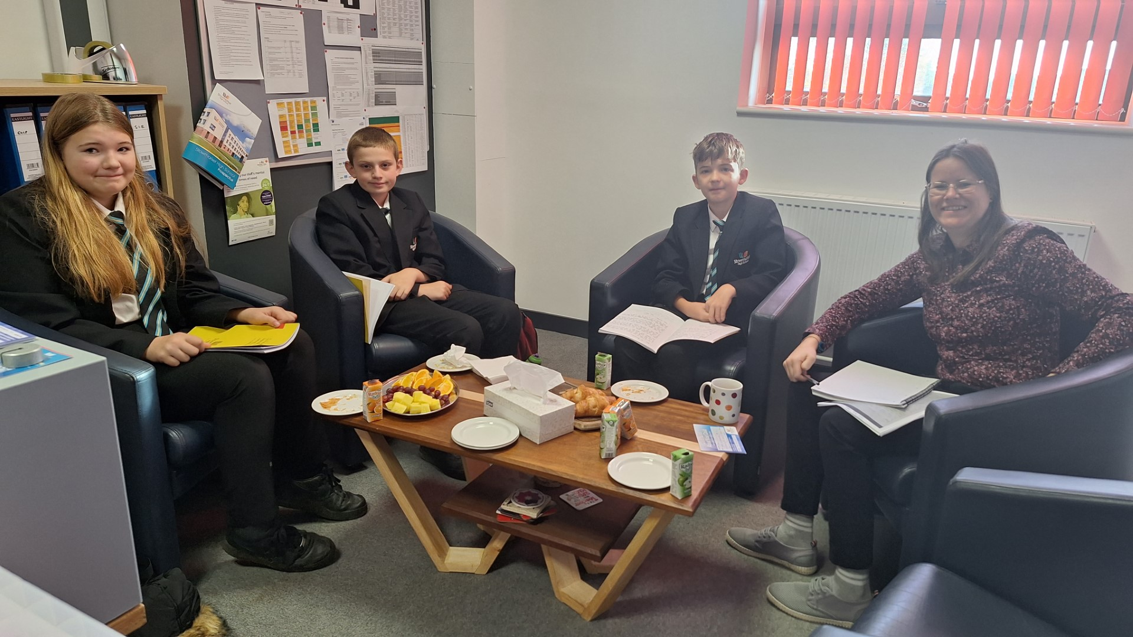
Headteacher’s Breakfast
Some of 7I had breakfast with Ms Hernandez and presented their persuasive letters about issues they are passionate about relating to the school community.

